Slide 1
FTP - File Transfer Protocol
TFTP – Trivial FTP
CISC 856 – Fall 2007
Brian Lucas
University of Delaware
(some/most slides courtesy of
Umakanth Puppala, William Boyer
Vikram Rajan, Michael Haggerty, and Prof Amer)
lucasb@capsl.udel.edu

Slide 2
Overview
File Transfer Protocol (RFC 959)
  Why FTP?
  FTP’s connections
  FTP in action
  FTP commands/responses
Trivial File Transfer Protocol (RFC 1350)
  TFTP and TFTP’s message formats
  FTP and TFTP compared

Slide 3
Why do we need a FTP Service?
Purpose: To Transfer files between two computers
Goals of FTP Service
  Promote sharing of files (programs and/or data)
  Encourage indirect/implicit use of remote computers
  Shield users from variations in file storage among hosts
  Transfer data reliably and efficiently

Slide 4




Problems of File Transfer
At first, file transfer may seem simple
Heterogeneous systems use different:
  Operating Systems
  Character Sets
  Naming Conventions
  Directory Structures
  File Structures and Formats
FTP needs to address and resolve these problems

Slide 5


FTP’s Connections
2
* Persistent command
and reply connection
* Insulates users from “raw”
FTP commands
client
Non-persistent data
connection
Server is listening on port 21
for connection requests
*Server uses port 20
for data connections
* Routes “raw” FTP commands
* Receives server’s replies
User
Interface
server
User
Protocol
Interpreter
Control
Connection
Server
Protocol
Interpreter
21
User
Data Transfer
Function
Data
Connection
Server
Data Transfer
Function
20

Slide 6
FTP’s Connections – Establishment
2
ftp> open strauss.udel.edu
Connected to strauss.udel.edu
220 strauss FTP server ready.
client
331 Password req for lucasb.
Password:
User
Interface
230 User lucasb logged in.
ftp>
USER lucasb
PASS mypass
server
User
Protocol
Interpreter
Control
Connection
Server
Protocol
Interpreter
User
Data Transfer
Function
Data
Connection
Server
Data Transfer
Function

Slide 7

FTP’s Connections
Data Transfer
2
client
ls client.txt
-rw-r--r-- lucasb client.txt
User
Interface
128.4.40.17 (19×256)+137
128.4.40.17:5001
226 Closing Data Connection
128.4.40.17 19,137
200 Port Command Sucessful
LIST client.txt
PORT 128,4,40,17,19,137
150 Data Connection will be open shortly
server
User
Protocol
Interpreter
User
Protocol
Interpreter
Server
Protocol
Interpreter
Control
Connection
Server
Protocol
Interpreter
Passive open on
Port 5001
User
Data Transfer
Function
Data
Connection
Server
Data Transfer
Function
Establish Data Connection

Slide 8
FTP’s Connections – Connection Closing
2
bye
client
User
Interface
221 Service Closing
QUIT
server
User
Protocol
Interpreter
Control
Connection
Server
Protocol
Interpreter
User
Data Transfer
Function
Data
Connection
Server
Data Transfer
Function

Slide 9
FTP Connection
Client
Server
ftp> open server
Eph
SYN
SYN|ACK
21
ACK
220 Service Ready
ACK
ftp> USER lucasb
ACK
331 User OK,password?
ACK
ftp> PASS mypass
ACK
230 User login OK
ACK

Slide 10
FTP Data Transfer
Client
Server
PORT 128,4,40,17,19,137
Eph
ACK
21
200 Command Successful
LIST client.txt
ACK
ACK
SYN
20
5001
SYN-ACK
ACK
150 Data Connection will be open shortly
ACK
NAME LIST
FIN
Eph
Control connection
21
FIN-ACK
5001
Data Connection
20
ACK
226 Closing Data Connection
ACK

Slide 11
FTP Client Commands (issued by user interface)
Command | Description
get filename | Retrieve file from server
mget filename* | Retrieve multiple files from server*
put filename | Copy local file to server
mput filename* | Copy multiple local files to server*
open server | Begin login to server
bye / close / exit | Logoff server
ls / dir | List files in current remote dir on server
lcd | Change local directory
cd | Change remote directory
rhelp / remotehelp | Lists commands the server accepts
* Sent to server as multiple command by User Protocol Interpreter

Slide 12
A-PDU FTP Commands
Command | Description
LIST [filelist ] | List files or directories (ls / dir)
USER username | Send username to server
PASS password | Password on server
PORT h1,h2,h3,h4,p1,p2 | Client IP and port number
RETR filename | Retrieve (get) filename
STOR filename | Store (put) filename
TYPE (A, I, E, N or T) | Defines the file type or print format

Slide 13
FTP Response format
Reply | Description
1yz 2yz 3yz 4yz 5yz | Positive preliminary reply.The action is being started but expect another reply before sending another cmd. Positive completion reply. A new cmd can be sent. Positive intermediate reply. The cmd has been accepted but another cmd must be sent. Transient negative completion reply. The requested action did not take place but can be sent later Permanent negative completion reply. Cmd not accepted and should not be reissued.
x0z x1z x2z x3z x4z x5z | Syntax errors Information Connections. Replies referring to control or data connections. Authentication and accounting Unspecified Filesystem status

Slide 14
Example FTP Responses
120 Service will be ready shortly
200 Command OK
230 User login OK
331 User name OK; password is needed
421 Service not available
530 User not logged in
552 Requested action aborted; exceeded storage allocation

Slide 15
Summary of FTP connections
FTP has 2 connections
  Control (persistent connection)
    Server issues a passive open on well-known 21
    Client uses an ephemeral port to issue active open
    Server ultimately closes control connection
  Data (ephemeral connection)
    Client issues passive open on an ephemeral port
    Client sends this port to server via PORT command
    Server receives the port number and issues active open using its well-known 20 to the received ephemeral port

Slide 16
Data Connection
Connection does not always work…why?
Instead, use PASV command
  Client sends PASV command to server
  Server chooses ephemeral port: passive open
  Server responds with IP, Port in reply (227)
  Client issues active open to server’s port
Ultimately, the data sender closes connection

Slide 17

FTP Passive Data Transfer
client
ls client.txt
-rw-r--r-- lucasb client.txt
User
Interface
226 Closing Data Connection
227 Entering Passive Mode (128,4,40,42,20,5)
PASV
LIST client.txt
150 Data Connection will be open shortly
server
User
Protocol
Interpreter
User
Protocol
Interpreter
Server
Protocol
Interpreter
Control
Connection
Server
Protocol
Interpreter
Passive open on
Port 5125
User
Data Transfer
Function
Data
Connection
Server
Data Transfer
Function
Establish Data Connection

Slide 18
Trivial FTP (TFTP)
Used only to read and write files from/to a remote server
  Cannot list directories
Useful for bootstrapping diskless systems
  Workstations
  X terminals
TFTP
UDP
IP
Ethernet
Physical
Notes:
TFTP uses the services of UDP on well known port 69.

Slide 19
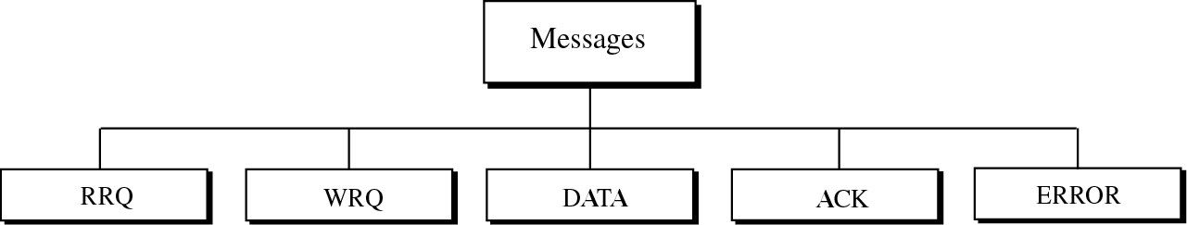
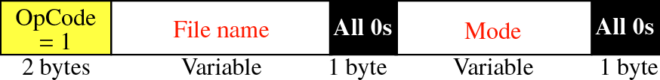
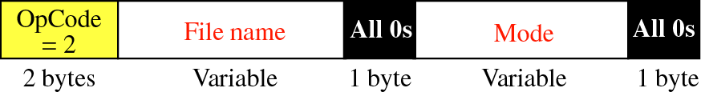
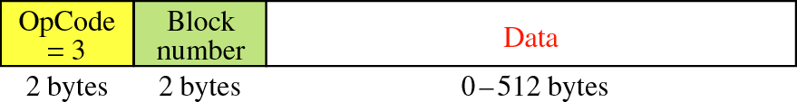
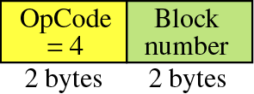
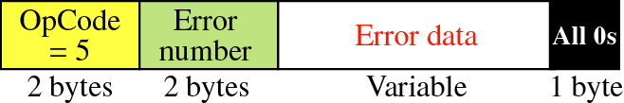
TFTP Message Formats
Diagrams from McGraw-Hill
Notes:
RRQ: client to establish a connection for reading data from the server.
WRQ: write data from the client to the server
DATA: All data bytes are exactly 512 bytes long except the last block which is between 0 and 511 bytes…EOF indicator – if data is in exact multiples of 512, sender must send one extra block of zero bytes. DATA can be in NVT ASCII or octet (binary format)
ACK: Block number is a 2byte field containing the number of the block received

Slide 20
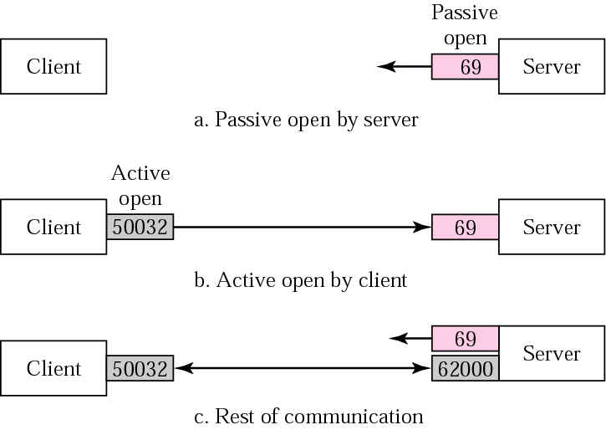
TFTP Connection Establishment
Diagram from McGraw-Hill

Slide 21
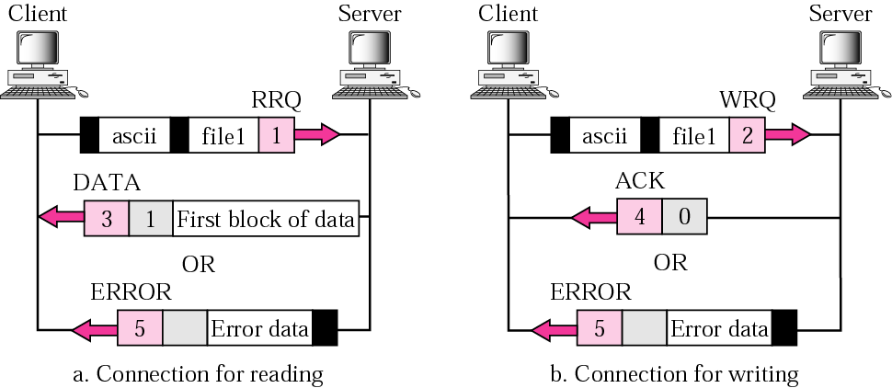
TFTP Data Transfer
Diagram from McGraw-Hill

Slide 22
TFTP Connection
Client
Server
Read Request
Eph
RRQ “fullOS”
69
First Block of
512 Bytes Sent
DATA 1
Eph
ACK 1
DATA 2
Block 2 Lost
Timeout
DATA 2
ACK 2
DATA 3
Block 3 Damaged
Timeout
DATA 3
ACK 3
DATA 4
Timer
running
ACK 4
Timeout
ACK 4 Lost
ACK 4

Slide 23
TFTP Connection (cont’d)
Client
Server
DATA 5
ACK 5 is Slow
Timeout
ACK 5
DATA 5
Discard Duplicate
ACK 5
DATA 6
ACK 6
DATA 6
Resend Data 6
Data is Sent
Twice, Known as
The Sorcerer's
Apprentice Bug
ACK 6
DATA 7
ACK 7
DATA 7
Block 8 is the Last
Block (383 Bytes)
ACK 7
DATA 8
ACK 8
DATA 8
ACK 8

Slide 24
FTP vs. TFTP
FTP | TFTP
2 connections: control (21) and data (20) | 1 connection (69), stop and wait flow
Reliable service using TCP | Uses UDP, handles own retransmissions
Many commands | 5 message types, only reads/writes files
Minimal security using logon procedure | No logon or security
Larger code size, full-featured | Lightweight, designed to fit on ROM

